Slide 1


UNIT 4: Clocks and calendars
My granny

Slide 2
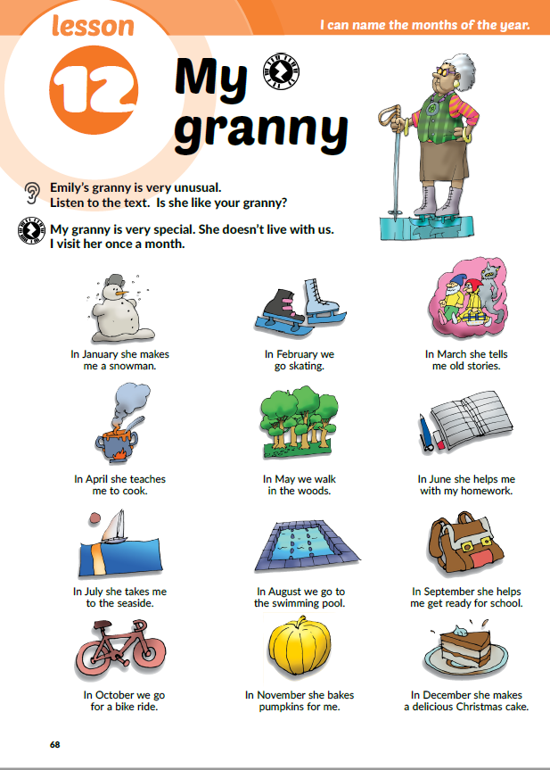
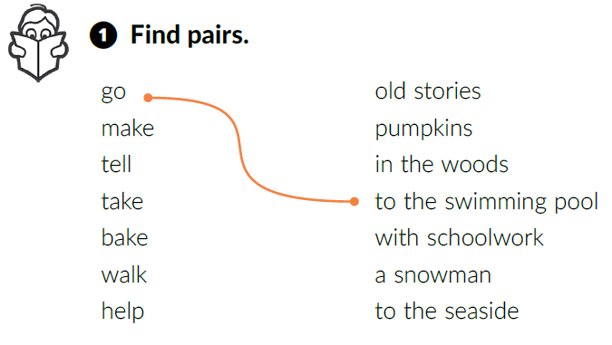

Where does your granny live?
Do you spend a lot of time together?
Is your granny unusual?
Listen again and match the expressions.
Name the things you can see.
Listen and answer. Is Emily’s granny like your granny?

Slide 3
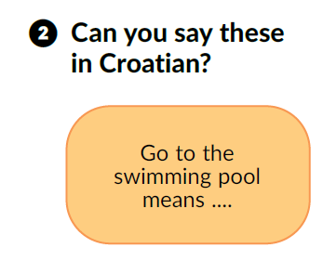
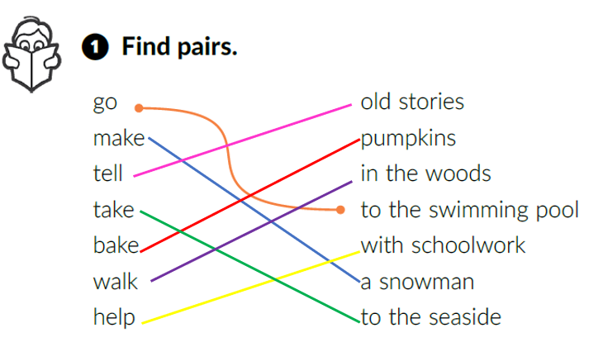
Copy the expressions in your notebook and translate them.
pričati stare priče
peći bundeve
šetati šumom
ići na bazen
pomoći s učenjem
napraviti snjegovića
odvesti na more

Slide 4
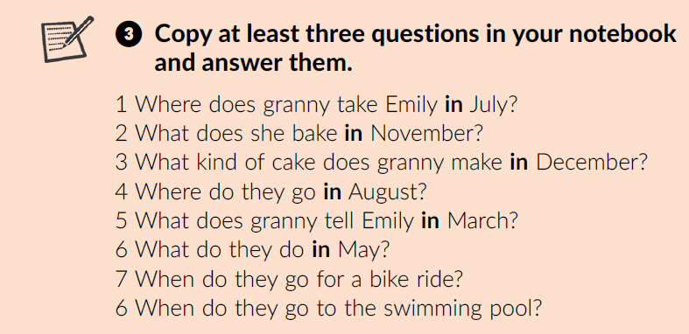
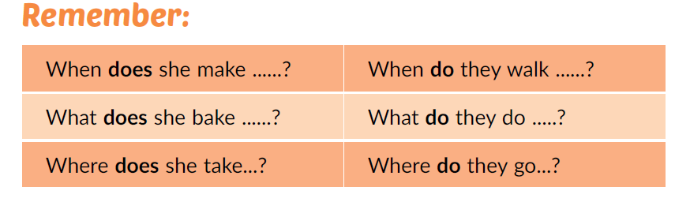
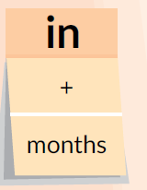
Underline the question words in task 3.
When do we use the preposition in?
We use it with months of the year.
How do we form questions?
Question word + do/does + subject + infinitive

Slide 5
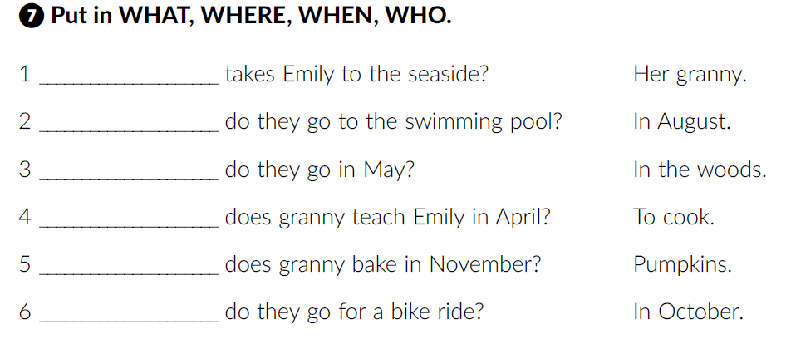
Workbook, p. 49
Who
When
Where
What
What
When
Let’s play and learn!
https://wordwall.net/resource/256599/where-does-the-cat-sleep-pg-54-2
https://wordwall.net/resource/256600/where-does-the-cat-sleep

Slide 6
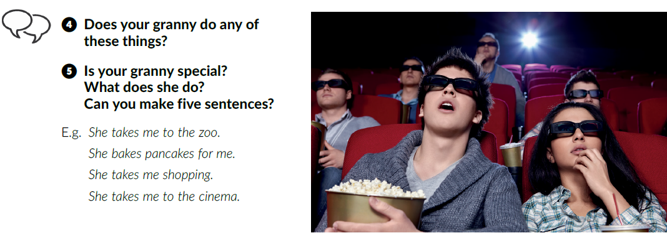

Write the sentences about your grandma in your notebook.
Learn more: It’s a dog’s life.
Read the text and complete the tasks below.
https://www.e-sfera.hr/dodatni-digitalni-sadrzaji/6452258a-ba6e-477a-979e-a5744a0bc5ae/

Slide 7
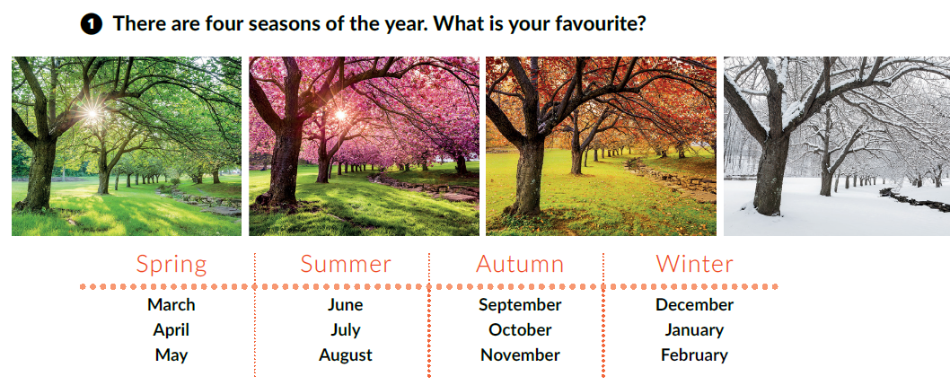
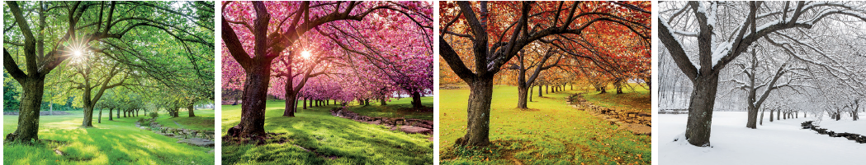
Describe the photos.

Slide 8
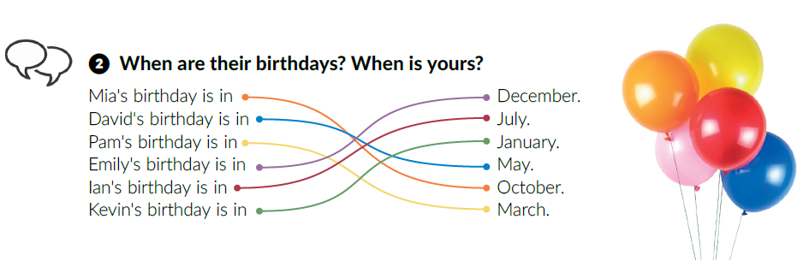
When is your birthday?
Solve the crossword.
https://wordwall.net/resource/260260/months-and-seasons
Complete the tasks.
https://wordwall.net/play/260/277/816
https://www.e-sfera.hr/dodatni-digitalni-sadrzaji/6452258a-ba6e-477a-979e-a5744a0bc5ae/ - Marko’s holidays

Slide 9
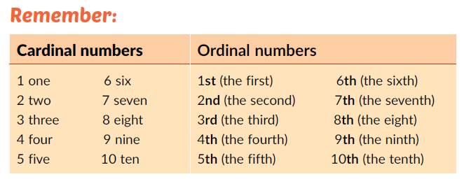
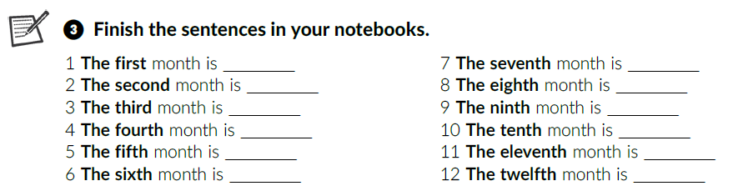
Glavni brojevi
Cardinal numbers =
Ordinal numbers =
Redni brojevi
Copy the ordinal numbers in your notebook.
January
July
February
August
March
September
April
October
May
November
June
December

Slide 10
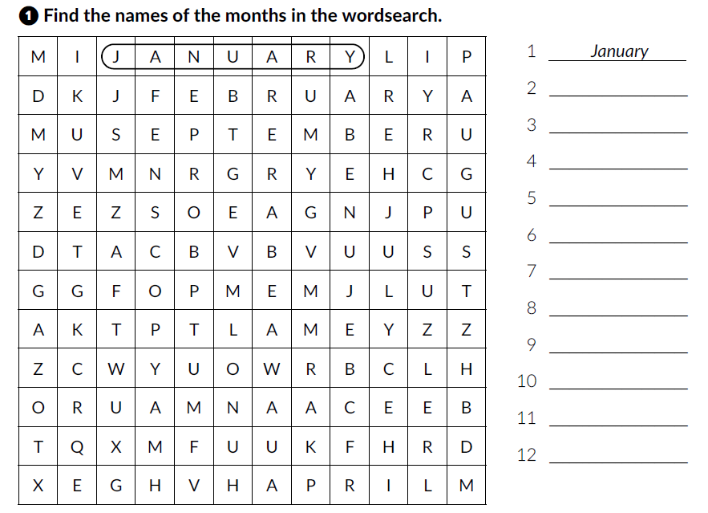
Workbook, p. 47 & 48
February
March
April
May
June
July
August
September
October
November
December

Slide 11
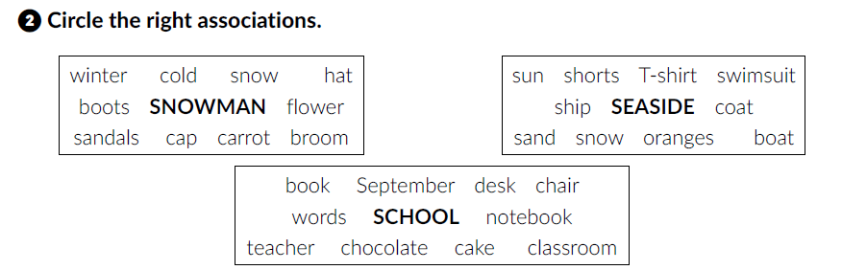
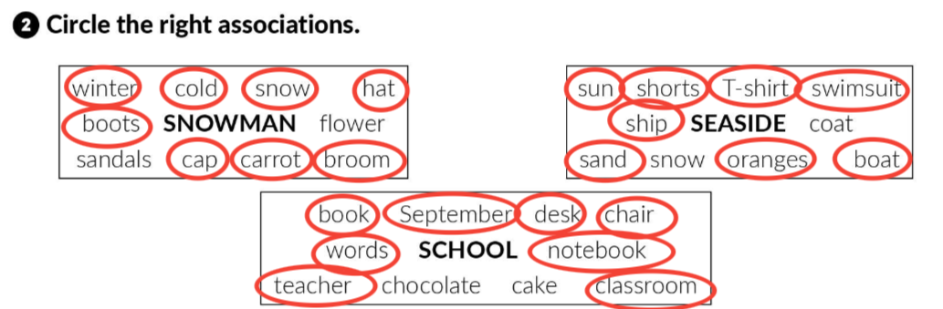
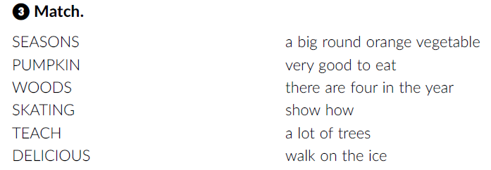

Slide 12
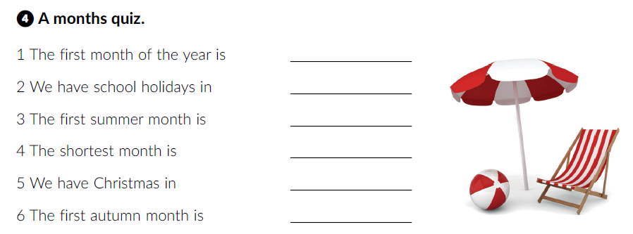
January
July and August
June
February
December
September

Slide 13
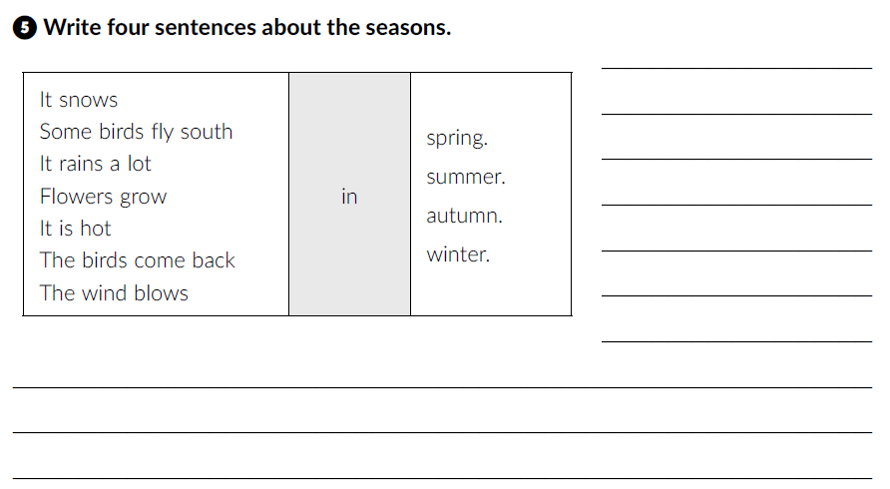
It snows in winter.
Some birds fly south
in winter.
It rains a lot in autumn.
Flowers grow in spring.
It is hot in summer.
The birds come back in spring.
The wind blows in autumn.

Slide 14
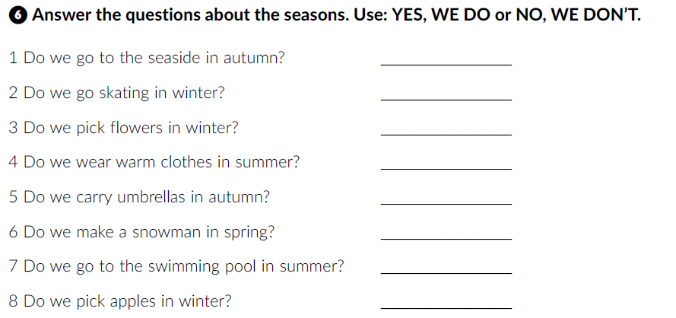
No, we don’t.
Yes, we do.
No, we don’t.
No, we don’t.
Yes, we do.
No, we don’t.
Yes, we do.
No, we don’t.
Click on the following link and choose Self check. Complete the tasks.
https://www.e-sfera.hr/dodatni-digitalni-sadrzaji/6452258a-ba6e-477a-979e-a5744a0bc5ae/
Choose Learn more: Months of the year and complete the tasks.

Slide 15
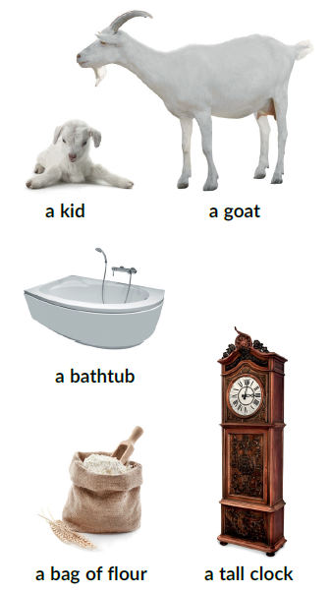
Can you name a few fairy tales or fairy tale characters?
Use the PowerPoint presentation Fairy tales.
Describe the pictures.
Listen to the fairy tale.
How many animals can you find in it?

Slide 16
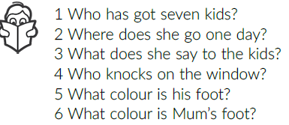
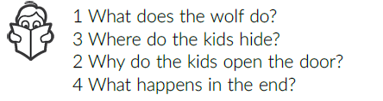
Listen to the fairy tale again and answer the questions.
A goat has got seven kids.
One day she goes to town.
‘Don’t open the door to anyone.’
A wolf knocks on the window.
His foot is black.
Mum’s foot is white.
He puts his foot in the bag of flour.
One kid hides in a cupboard, one in a big box, one behind an armchair, one in the bathtub, two under the bed and one in the tall clock.
Because they think it’s their mum.
Mother goat saves her kids.

Slide 17
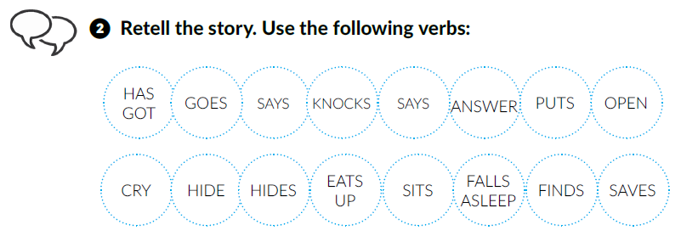
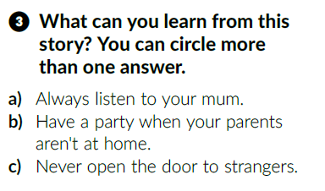
You can work in pairs first.

Slide 18
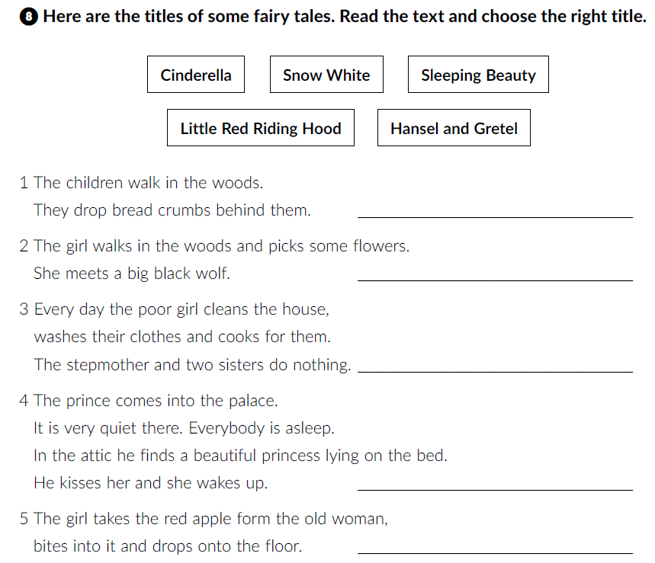
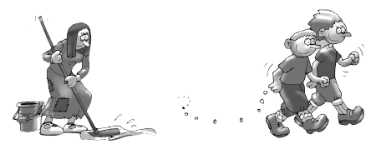
Workbook, p. 49,50.
Hansel and Gretel
Little Red Riding Hood
Cinderella
Sleeping Beauty
Snow White

Slide 19
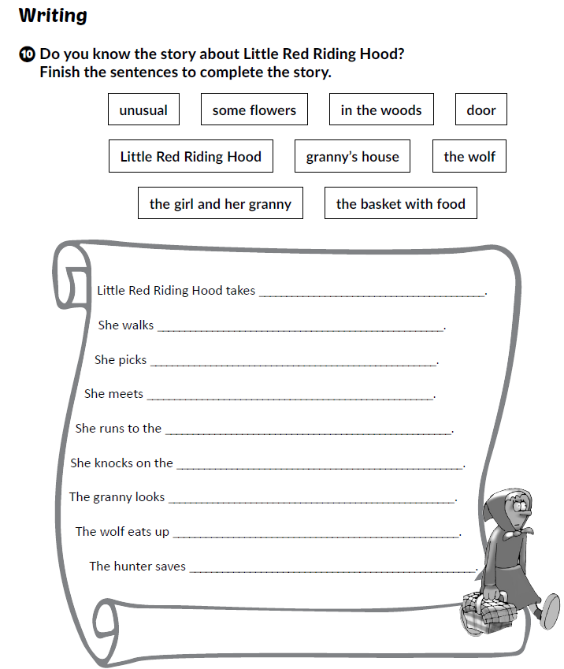
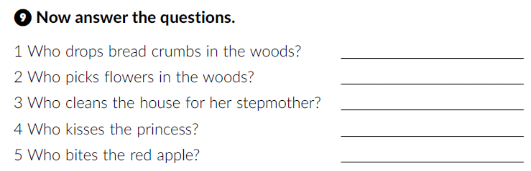
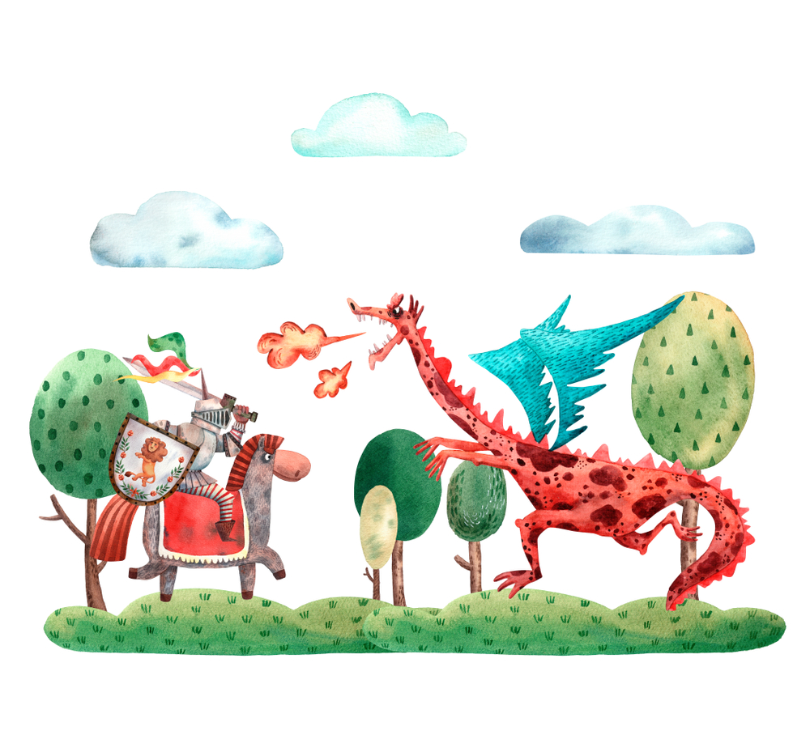
Hansel and Gretel
Little Red Riding Hood
Cinderella
The prince
Snow White

